Slide 1
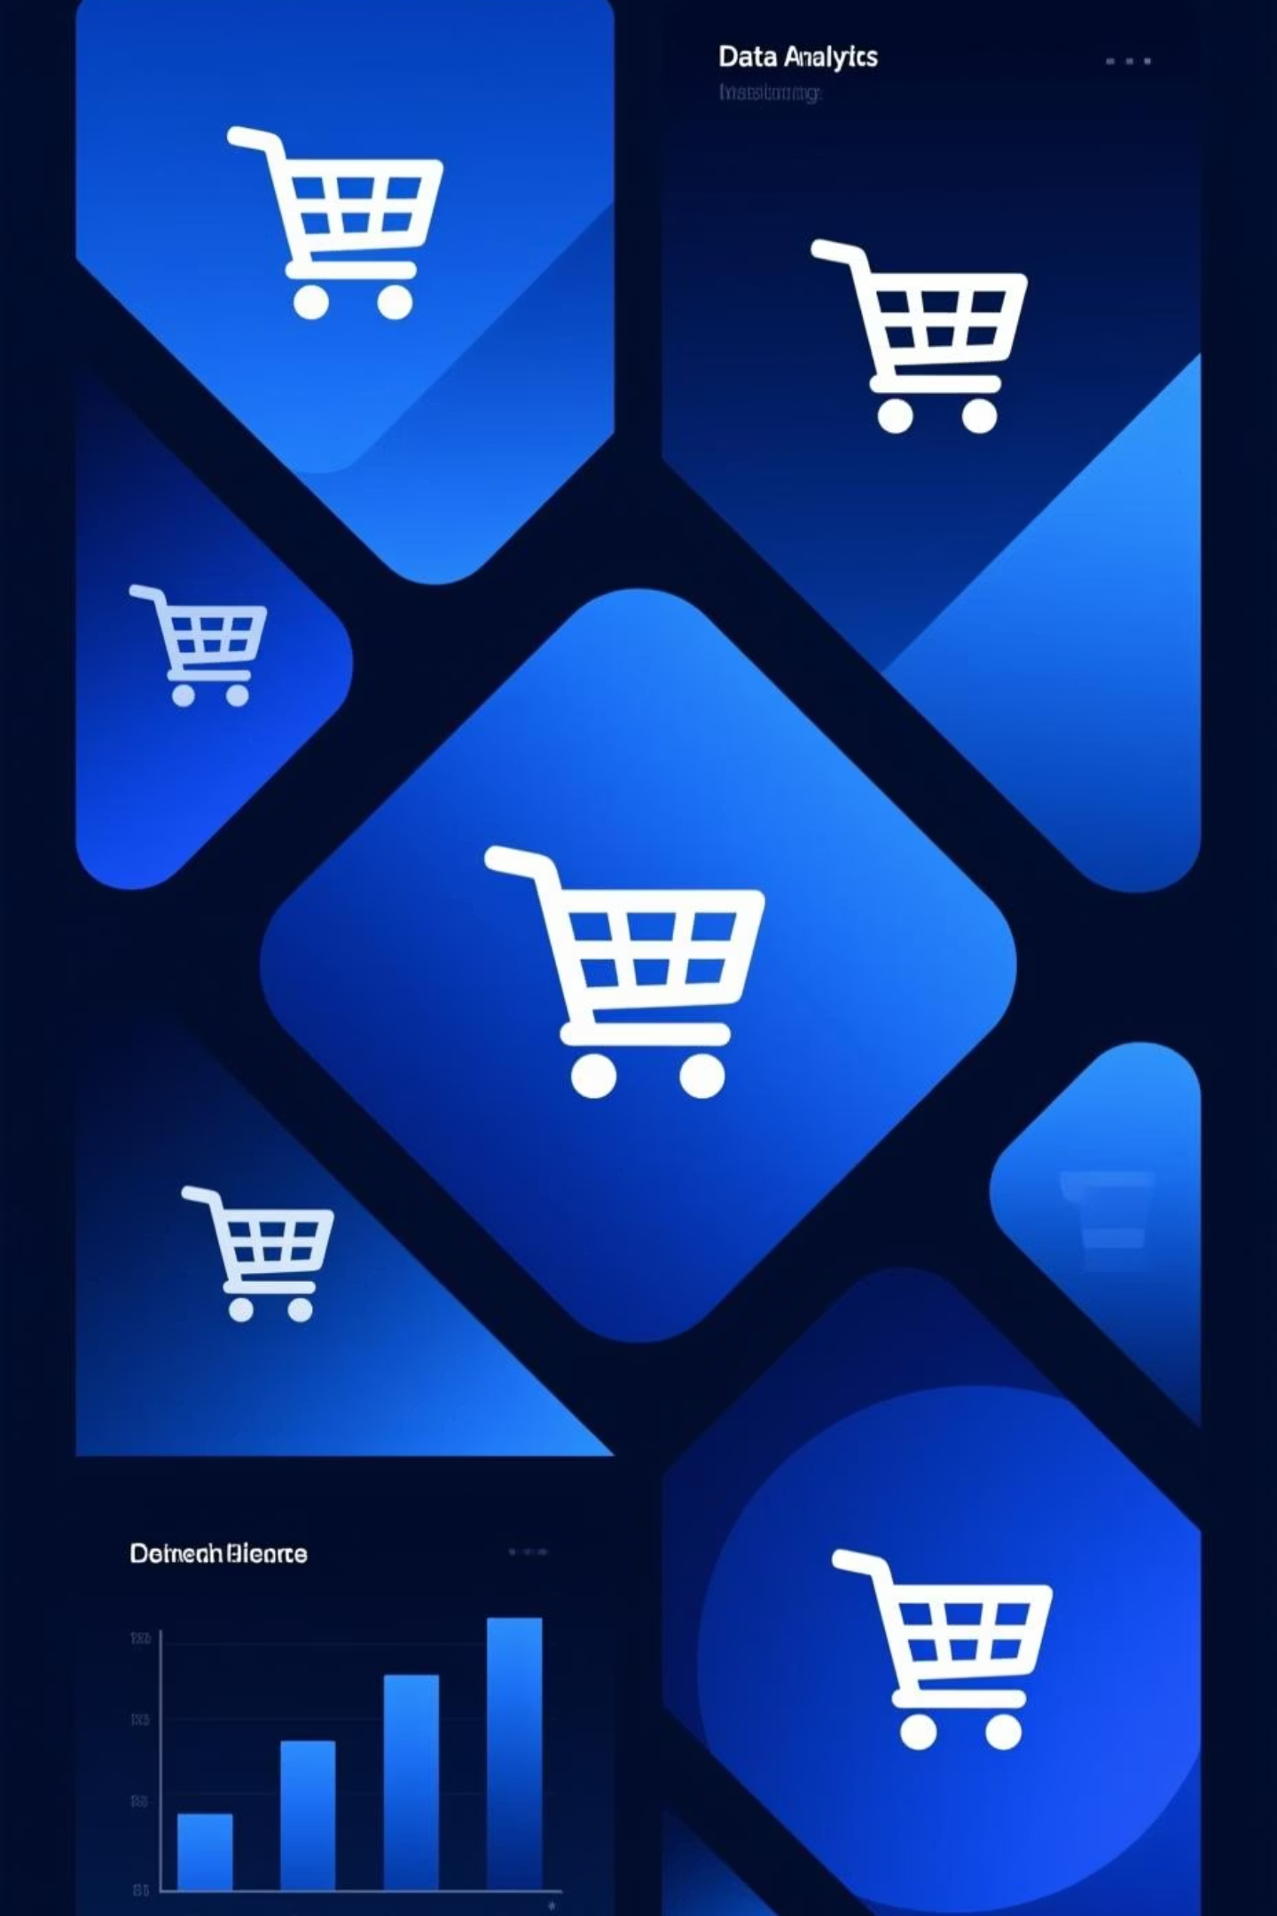
Customer Shopping Behavior Analysis
This end-to-end data analysis project demonstrates advanced capabilities in examining comprehensive customer transaction data and deriving strategic retail insights. It showcases a robust methodology, detailed in the project doc, leveraging Python, PostgreSQL, and Power BI to transform raw data into actionable intelligence and highlights a strong command of modern data analytics techniques.

Slide 2


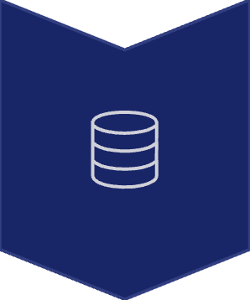
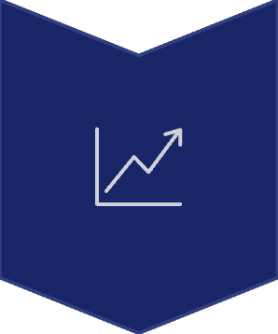
PROJECT OVERVIEW
Complete Data Lifecycle
This document details the methodological approach taken across the entire data lifecycle.
Data Cleaning
Python for data transformation and preparation
Storage & Querying
PostgreSQL for robust database management
Visualization
Interactive Power BI dashboards to showcase insights

Slide 3

TECH STACK
Tools & Technologies
Python 3.x
PostgreSQL
Utilized for robust data manipulation, scripting, and automation, showcasing proficiency in libraries like Pandas, NumPy, and SQLAlchemy.
Implemented for efficient, scalable relational data storage and complex querying, forming the core of the project's data foundation.
Power BI
Jupyter Notebook
Developed interactive dashboards and reports to visualize key insights, demonstrating strong capabilities in data storytelling and presentation.
Served as the primary environment for iterative development, exploratory analysis, and documenting the project's methodology (as presented in this doc).

Slide 4

Dataset Composition
This project demonstrates capability in comprehensive analysis of customer transaction records, emphasizing a robust methodology across various dimensions. The accompanying doc elaborates on the analytical techniques employed.
Customer Profile
Transaction Data
Demographics: Age, Gender, Location
Item Purchased & Category
Transaction Value
Subscription Status
Seasonal Patterns
Previous Purchases
Review Ratings
Purchase Frequency

Slide 5
DATA CLEANING
Python Transformation Process
This section of the doc highlights the methodology employed for data cleaning and transformation, demonstrating robust data processing capabilities.
01
02
Missing Value Treatment
Standardization
Implemented a comprehensive strategy for imputing missing values in critical fields, ensuring data integrity for subsequent analysis.
Applied consistent formatting to column names, converting them to lowercase with underscores for optimal SQL compatibility and ease of use.
03
04
Feature Engineering
Redundancy Removal
Developed new analytical features from raw data, such as categorizing demographic information and transforming temporal metrics, to enhance model performance.
Systematically identified and dropped non-essential or redundant columns, streamlining the dataset for efficient processing.

Slide 6
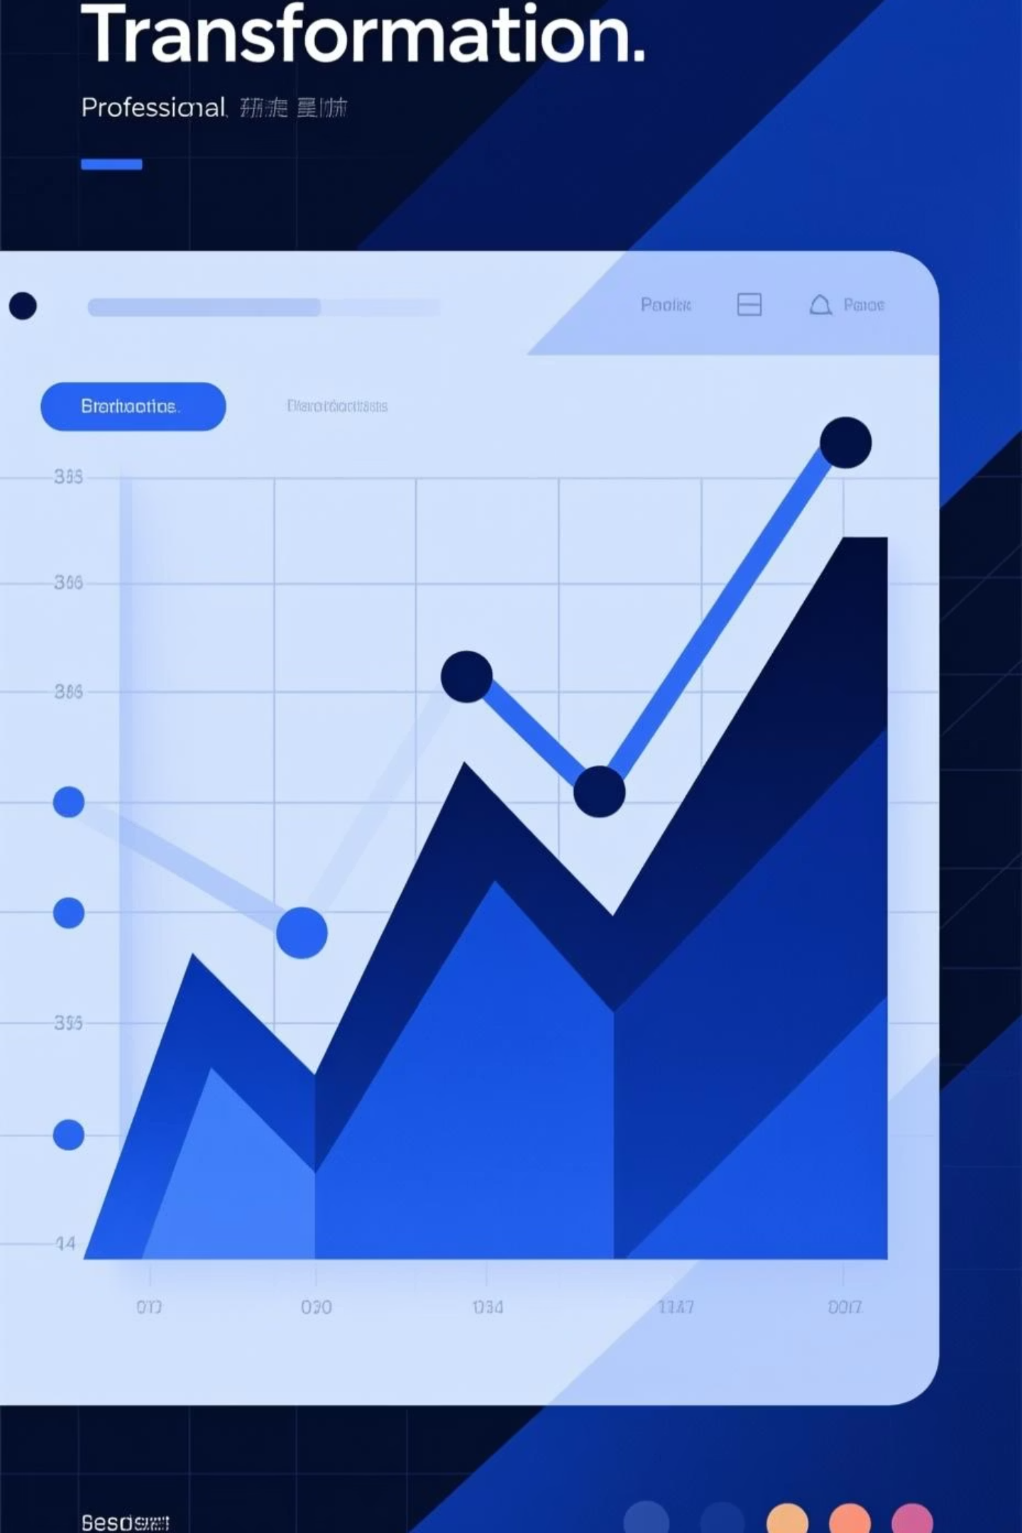
Feature Engineering Highlights
Age Grouping
Demonstrated capability in customer segmentation by categorizing user data into distinct groups (e.g., Young Adult, Adult, Middle-aged, Senior) using quantile-based binning (pd.qcut). This process, documented in this project, enhances analytical precision without relying on specific demographic figures.
Frequency Mapping
Showcased proficiency in data transformation by converting various categorical frequency terms (e.g., Weekly, Fortnightly) into a standardized numeric purchase_frequency_days. This method, outlined in the project doc, enables robust quantitative analysis and models without presenting specific user statistics.

Slide 7

DATABASE LAYER
PostgreSQL Integration
This section of the doc highlights the integration of PostgreSQL, demonstrating robust database management and analytical capabilities developed within this portfolio project.
Automated Workflow
Used SQLAlchemy engine to automate table creation and data insertion from Python, showcasing efficient data pipeline development.
SQL Analysis
Executed queries to identify various business patterns and trends, demonstrating analytical proficiency and insight generation.
SELECT category, SUM(purchase_amount) as total_sales
FROM customer
GROUP BY category
ORDER BY total_sales DESC;

Slide 8
Power BI Dashboard
This project demonstrates dynamic visualization capabilities, effectively connecting PostgreSQL data to interactive business intelligence reports. The accompanying doc details the full implementation process and showcases a robust approach to data analysis, emphasizing capabilities rather than specific results.
Sales Overview
Category Performance
Developed visualizations to track overall sales performance and key purchase metrics, showcasing comprehensive data integration.
Analyzed and presented performance trends across various product categories, illustrating data interpretation skills.
Customer Segmentation
Regional Insights
Demonstrated customer segmentation methods, breaking down purchasing behavior across different demographic groups.
Visualized geographic sales data to identify regional patterns and market distribution, highlighting spatial analysis capabilities.

Slide 9

Scalable Business Intelligence Solution
This comprehensive project doc outlines a robust end-to-end data engineering process, moving from raw CSV data through relational database storage to interactive business intelligence visualization, showcasing a full spectrum of capabilities.
Prepare Data
Execute the Python notebook to clean and prepare data for PostgreSQL integration, demonstrating data transformation skills.
Access Data Repository
Utilize the PostgreSQL database for efficient data retrieval and complex analytical queries, highlighting database interaction proficiency.
Develop Dynamic Visualizations
Leverage Power BI to create interactive dashboards, refreshing data sources to present actionable insights derived from the processed data.

